Slide 1

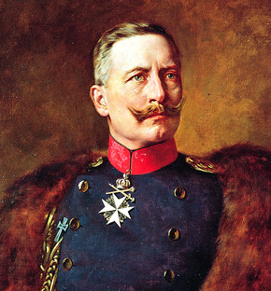
In 1914 Germany was a monarchy.

Slide 2
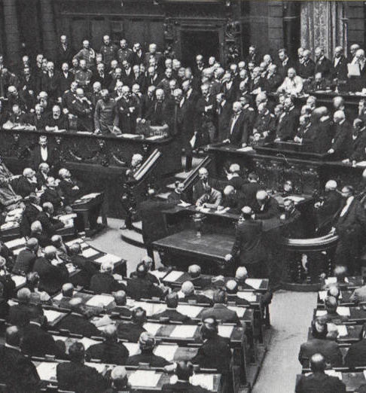
In 1919, it was a democracy.

Slide 3
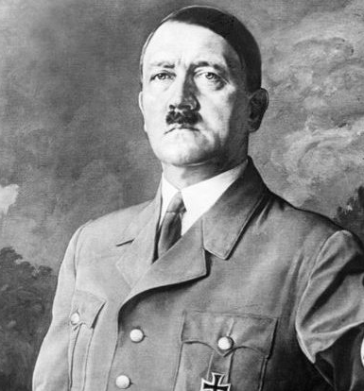
In 1933 it was about to become a dictatorship.

Slide 4
Big events like the collapse of a democracy do not just happen.
Nor are they inevitable.
There are many conditions and circumstances which create a situation in which change can occur, and then many choices which people make to cause that change to occur.
These conditions and circumstances create THREATS TO DEMOCRACY

Slide 5
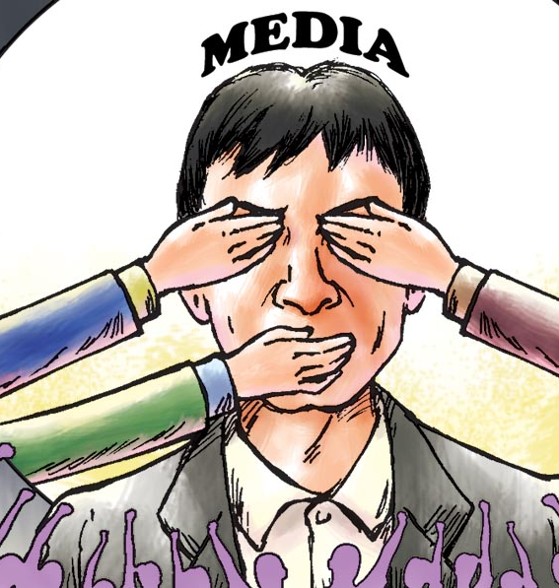

Threats to Democracy
There are threats to our democratic way of life that Australia must safeguard against

Slide 6
Before we discuss what threats to democracy are or how we can safeguard against them, lets revisit what a democracy is…

Slide 7

Democracy is a system of government with 4 key elements…
A system for choosing and replacing the government through free and fair elections
Active participation of the people, as citizens, in politics and civic life
Protection of the human rights of all citizens and,
A rule of law in which the laws and procedures apply equally to all citizens

Slide 8
Before we discuss what threats to democracy are or how we can safeguard against them, lets revisit what a democracy is…
Democracies are based on principles and Australia has devised its own set of values and principles which underpin our democratic way of life
GUESS the principle:
1. Write down the list of principles on the next slide
2. You will be shown a series of images – you need to match the image with the democratic principles from the list by writing down the image number

Slide 9
Australian Values and Principles
Respect for equal worth, and the dignity and freedom of the individual
Freedom of speech
Freedom of religion and secular government
Freedom of association
Support for parliamentary democracy and the rule of law
Equality under the law
Equality of men and women
Equality of opportunity
Peacefulness
A spirit of egalitarianism that embraces tolerance, mutual respect and compassion for those in need

Slide 10
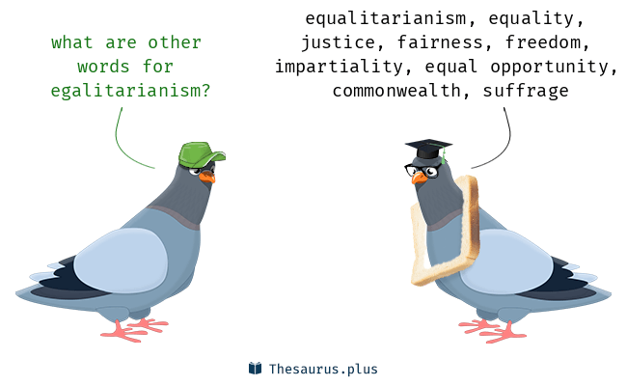

Slide 11
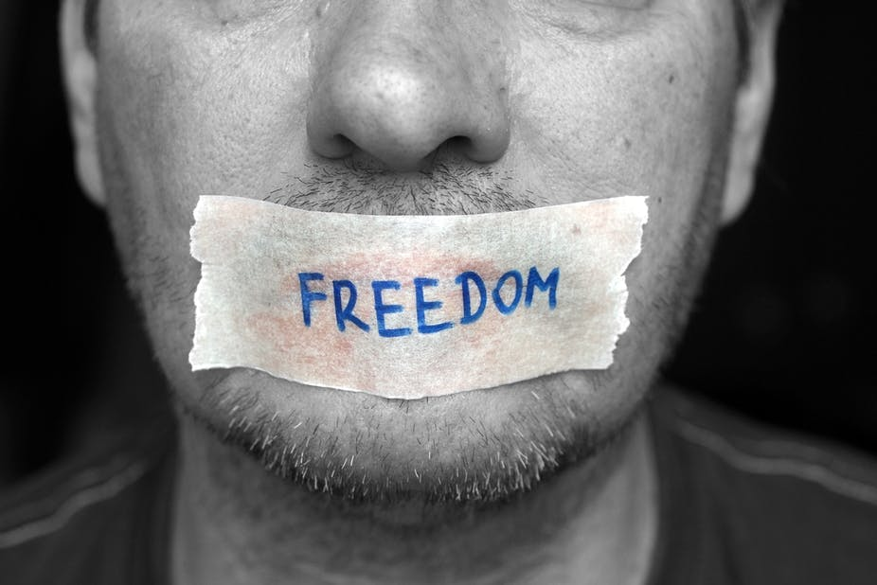
1

Slide 12
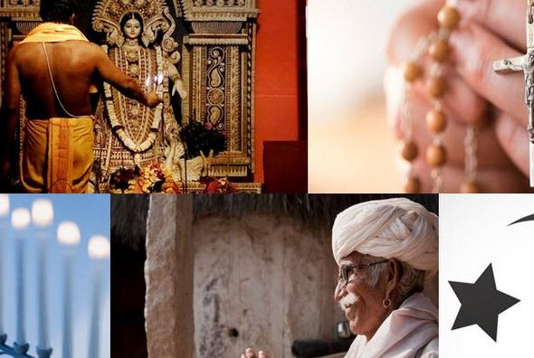
2

Slide 13

3

Slide 14
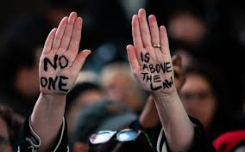
4

Slide 15
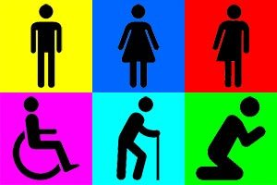
5

Slide 16
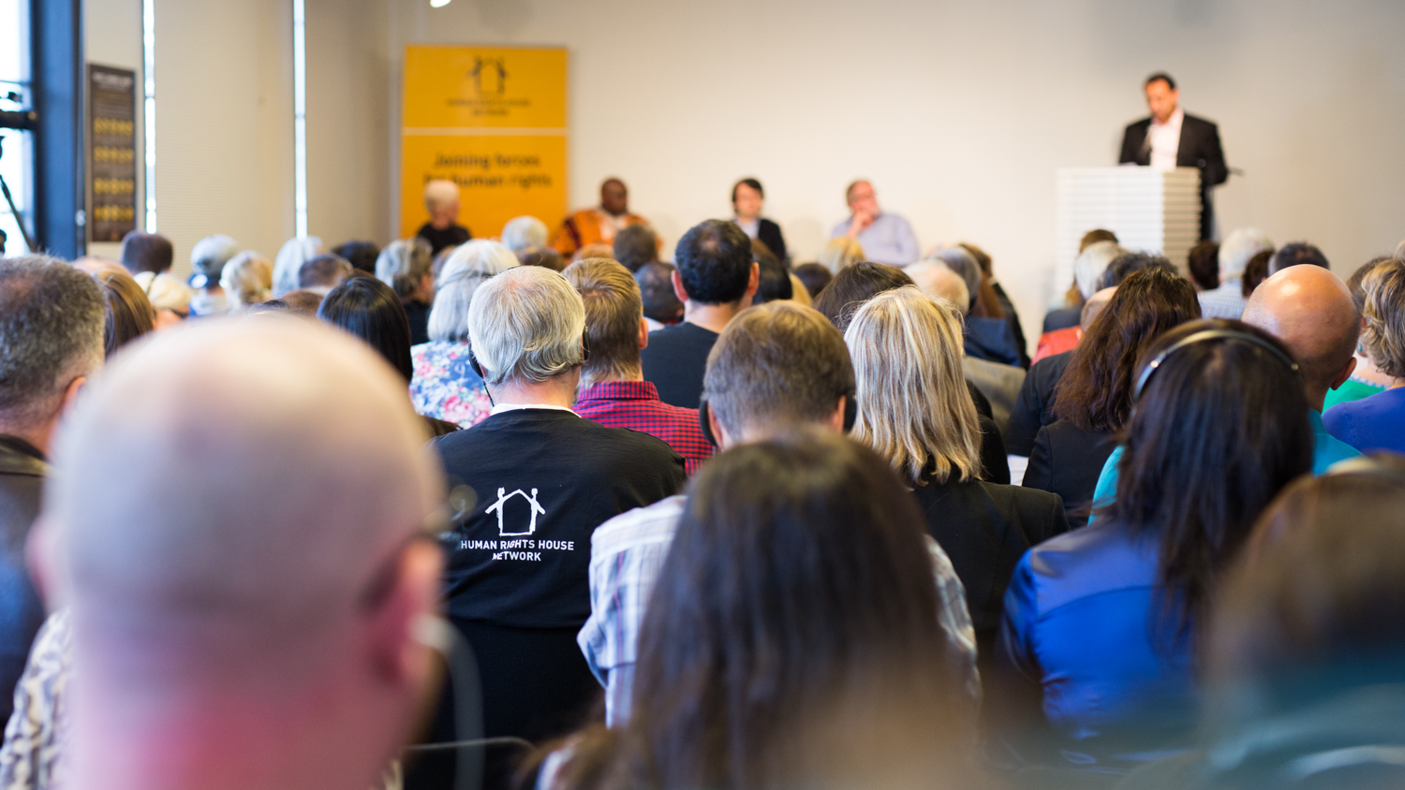
6

Slide 17

7

Slide 18
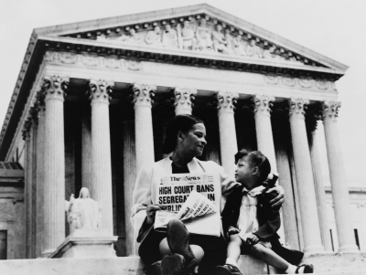
8

Slide 19
9

Slide 20
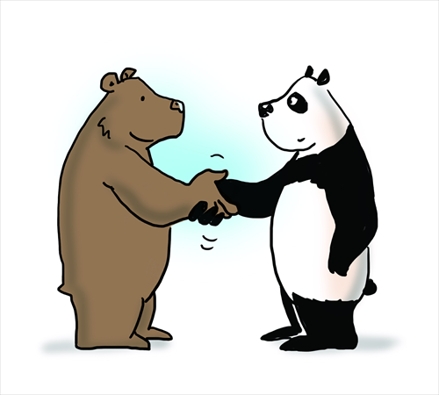
10

Slide 21
Answers

Slide 22
Freedom of Speech

Slide 23
Freedom of Religion

Slide 24
Equality for Men & Women

Slide 25
The Rule of Law

Slide 26
Equality of Opportunities

Slide 27
Freedom of Association

Slide 28
Peacefulness

Slide 29
Equality under the law

Slide 30
A spirit of egalitarianism that embraces tolerance, mutual respect and compassion for those in need

Slide 31
Equal Worth

Slide 32
Australia is a representative democracy…
This means that the citizens of Australia vote for people who represent them in parliament
It means that the citizens have the sovereign power but political power is exercised indirectly through elected representatives

Slide 33
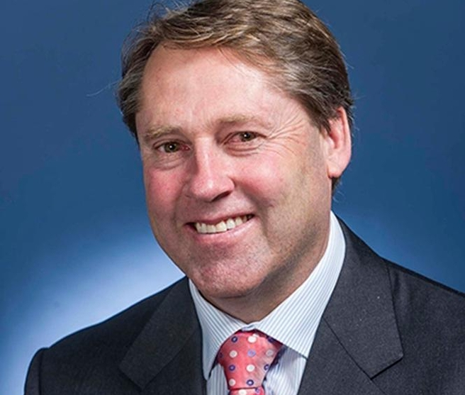
Rick Wilson is the elected representative in our Federal Parliament for those us who live in the O’Connor Electorate
Notes:
https://www.youtube.com/watch?v=apTVwQnf9co

Slide 34
“I think we take democracy for granted. I don’t think we actually know what a world without democracy would look like…”

Slide 35
What do you know about life in China?

Slide 36
“I think we take democracy for granted. I don’t think we actually know what a world without democracy would look like…”
https://www.youtube.com/watch?v=0cGB8dCDf3c
https://www.youtube.com/watch?v=Uzn8f38sw90

Slide 37
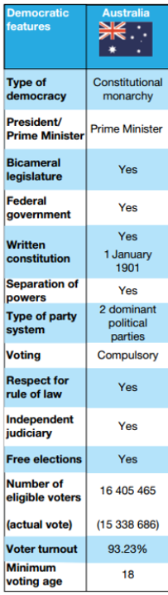
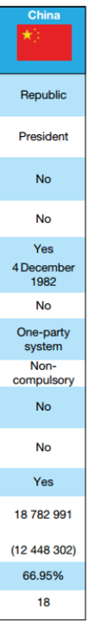

Slide 38
Democratic Features
Types of Democracy
President vs. Prime Minister
Bicameral legislature
Federal Government
Written Constitution
Separation of Powers
Type of party system (One Party vs. Multi-party)
Voting
Respect for the Rule of Law
Independent Judiciary
Free Elections
Notes:
https://www.youtube.com/watch?v=RLJBJ9LD0io
https://www.youtube.com/watch?v=v9VERBPU6_c

Slide 39
Safeguards to Australia’s democratic society
In order to have a strong society that is able to meet challenges, Australia’s system of government is based upon core beliefs and attitudes that are respected and valued by most people in our democratic society.
Our democracy is based on the prevailing beliefs that the people, in free and fair elections must elect the government and that the government must promote tolerance, cooperation and the freedom of the people by upholding basic human rights

Slide 40
Safeguard 1: The People Elect the Government
One main safeguard to Australia’s democracy is that each state, territory and Federal parliaments throughout Australia is elected by the people to make laws on their behalf.
Compulsory voting aims to make sure that our governments have the support of the majority of the people and not just those who bother to vote.

Slide 41
Safeguard 1: The People Elect the Government
Independent state and federal electoral commissions have the role of ensuring all state, territory and federal elections held throughout Australia are free, fair and conducted in accordance with state and Commonwealth law.
For example, the Australian Electoral Commission (AEC) is responsible for managing federal elections and maintaining the Commonwealth electoral roll, which lists the names and addresses of all eligible citizens who have enrolled to vote.

Slide 42
Safeguard 1: The People Elect the Government
The AEC must confirm that approximately 16 million people throughout Australia are able to cast their vote in secret.
This can be at venues or polling booths on election day or through postal votes for those who cannot attend a polling booth on the day of the election.
The AEC must also check that votes are honestly counted.
Notes:
https://www.youtube.com/watch?v=M3k1OUb-ifQ&feature=emb_rel_end

Slide 43
Safeguard 1: The People Elect the Government
It is important that votes cast their votes in secret to reduce the risk of voters being intimidated or voting for a person or party against their will.
Each citizen may only vote once and every vote has the same value, regardless of who it is.

Slide 44
Safeguard 2: Governments uphold our shared values
An underlying feature of democracy in Australia is that our parliaments and governments make and enforce laws that protect our shared values, so that all citizens are treated with dignity, equality and mutual respect.
For example, our laws protect a range of rights that are important to our society, including the right to:
A fair trial and freedom from torture
Life, liberty and security of person
Working and living in a healthy environment
Basic health care and education

Slide 45
Safeguard 2: Governments uphold our shared values
Governments aim to provide structures (including courts, tribunals, and government departments) and services (including hospitals, schools, universities, prisons, the defense and police forces) and social welfare benefits.
This is so that Australians can live together in a cohesive society where citizens cooperate and live together in a peaceful, inclusive and tolerant manner.

Slide 46
Safeguard 3: The Right to Dissent
Individuals generally have the right to oppose or disagree with the views held by the government.
We also publicly express that disapproval in a lawful manner without fear of being censored or punished.
For example, Australian law generally upholds the right to freedom of speech, press and protest, which allows individuals and organisations the ability to debate political issues and openly express their views without fear of being punished, although these rights are limited to a certain extent for reasons including to protect people from suffering harm as a result of other person making untrue statements or comments that are racially offensive and to protect the environment.

Slide 47
Processes to resolve disputes
In order to keep the peace in Australian society, processes exist to help individuals or groups resolve their problems or disputes.
This can include formal legal procedures that lead to a final decision or more informal discussions between parties that lead to settling a dispute or issue.

Slide 48
Processes to resolve disputes
Such processes might include the following in a formal court setting or informal domestic settings:
Negotiation – a process that uses discussion to try to reach a ‘win-win’ scenario for parties involved in a dispute.
Mediation – a type of negotiation that includes a formal mediator, or a person who is not part or the dispute, to assist the parties involved settle their dispute fairly
Reconciliation – the process of renewing a relationship between parties, which usually requires forgiveness on one or both sides
Without these kinds of processes in place and professionals to guide us, people would be left to resolve their issues themselves, which could result in much more aggressive outcomes.

Slide 49
Threats to Democracy:
Influence of Vested Interest Groups
Organised Crime
Corruption
Lawlessness

Slide 50
Threats to democracy
Organised crime, corruption, lawlessness and vested interests all threaten to destabilize democracies worldwide. These activities undermine and attack the principles of democracy. They seek to fulfil the goals of the self-interested individual or group rather than contribute to the betterment of society.

Slide 51
Influence of vested interests
Vested interests are individuals or groups within Australia that demand special privileges. They often pressure or lobby the government into formulating policies and enacting legislation to their advantage. Often disguised as being in the best interest of the nation, vested interests can be destructive to democracy. In the process of promoting their own objectives, real debate about important issues can become clouded or lost.

Slide 52
Influence of vested interests
Vested interest groups include more than big business.
Mining companies
think tanks
lobby groups,
refugee advocacy groups
education representatives and
public health organisations ;
all advocate to the parliaments for privileged consideration of their cause.

Slide 53
Dangers of vested interests to democracy.
In democracies the demands of vested interest groups should be tempered for a number of reasons.
Initiatives such as ‘industry partnerships’ grant programs and national frameworks can blur the lines between the government and the private sector.
The government’s overall legitimacy comes from the people who elect it. Allowing vested interest groups or powerful individuals outside parliament to have undue influence on policy and legislation is a violation of the sovereignty of parliament.
Companies often donate to political campaigns. This can influence the way politicians vote on bills and the bills they introduce.

Slide 54
Dangers of vested interests to democracy.
The vested interest can change the dynamic of political debate. Politicians are forced to manage the demands of vested interest groups rather than have an open discussion about the wider implications of policy.
Public lobbyists are funded by taxpayers, with little accountability for the use of the money.
Bodies that receive government grants and funding are less likely to scrutinize government policy, which is a key feature of living in a democracy.
The media is increasingly reliant on the promotion of the vested groups. This undermines freedom of press and information.

Slide 55
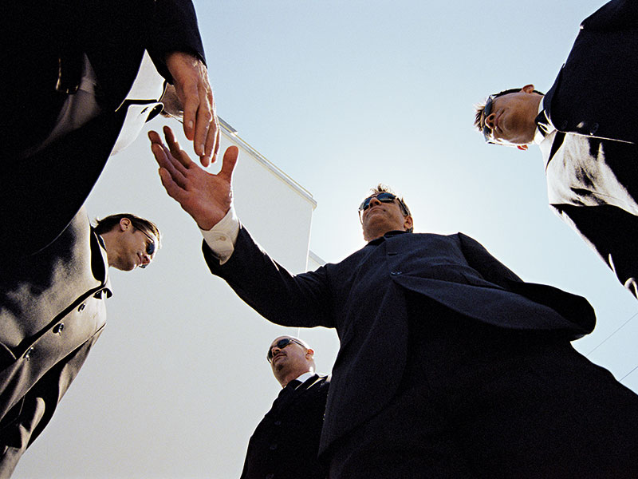
Organised Crime
https://www.acic.gov.au/publications/unclassified-intelligence-reports/organised-crime-australia

Slide 56
Organised Crime
The National Crime Authority Act 1984 defines organised crime as offences that:
Involve two or more offenders and substantial planning and organisation
Involve sophisticated methods or techniques
Are usually committed with similar offences
Involve theft, fraud, tax evasion, currency violations, illegal drug dealings, obtaining financial benefit by immoral behaviour by others, extortion, corruption, bankruptcy and company violations, harbouring of criminals, forging of passports, arms dealings or importation and exportation of fauna that involves matters of a similar kind

Slide 57
Organised Crime
The National Crime Authority Act 1984 defines organised crime as offences that:
Involve two or more offenders and substantial planning and organisation
Involve sophisticated methods or techniques
Are usually committed with similar offences
Involve theft, fraud, tax evasion, currency violations, illegal drug dealings, obtaining financial benefit by immoral behaviour by others, extortion, corruption, bankruptcy and company violations, harbouring of criminals, forging of passports, arms dealings or importation and exportation of fauna that involves matters of a similar kind

Slide 58

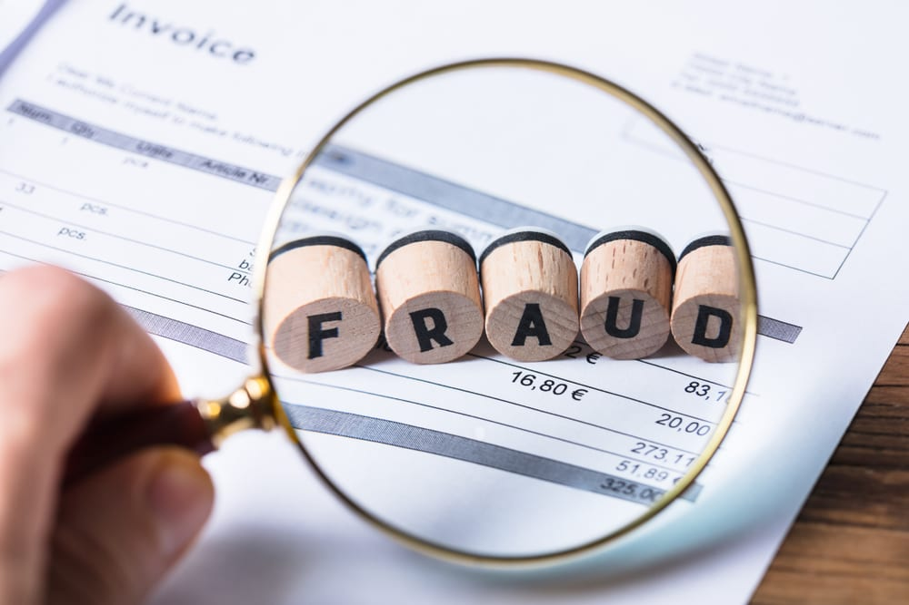
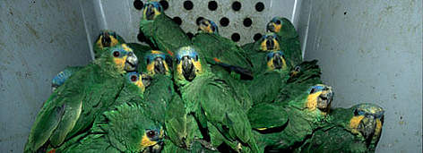

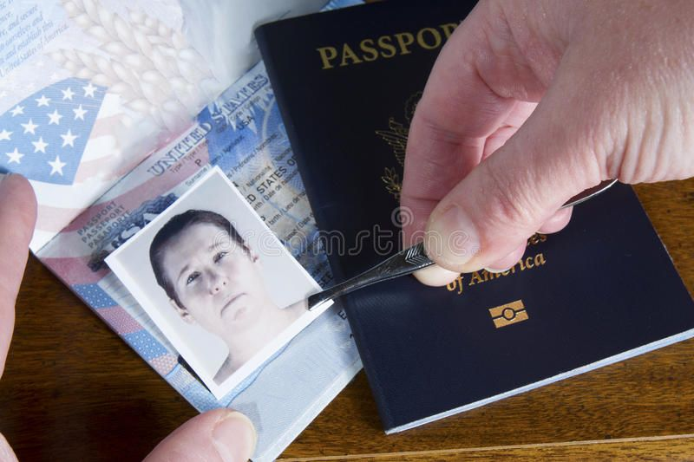
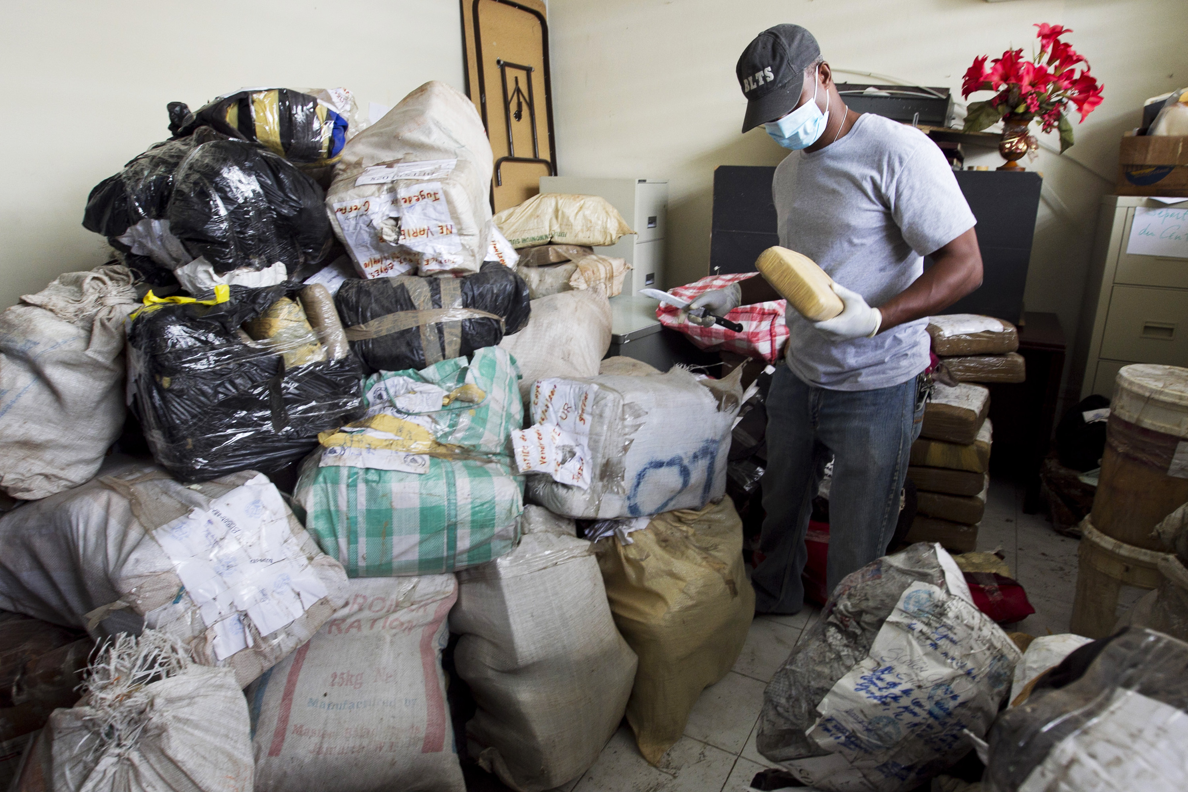

Slide 59
Organised Crime
In its most recent report, the Australia Crime Commission commented on the increased levels of sophistication employed by organised crime syndicates. The internet and technology have not only assisted criminal activity, but they have also created new ways of committing crimes, such as infiltrating legitimate and illegitimate markets.

Slide 60
Effects of Organised Crime on Democracy in Australia
Organised crime affects everyone.
It erodes the ability of the government to look after the public.
Overall the Australian Crime Commission estimates the cost of organised crime at $15 billion a year.

Slide 61
Global impacts of organised crime
Governments and citizens in the developing world are the common target for organised crime. Developing countries are often susceptible to corruption. They lack the technology and resources to fight sophisticated crime syndicates.
Organised crime can create mistrust between nation states, preventing goodwill and creating political instability within a region. This serves as a deterrent to trade, investment and legal assistance.

Slide 62
Global impacts of organised crime
Australian businesses are reluctant to invest in countries where bribes and corruption are common. This means that countries needing the revenue from foreign investment miss out.
Australian foreign aid money is wasted.
The Australian Defence Force and Australian Federal Police can be affected when they go to fight in overseas conflicts.

Slide 63
